Slide 2
Last time: why do individual macroeconomic indicators (including growth rates) show counter-intuitive relationships with default rates? (After scaling/normalization)
Focus on the different people joining throughout different years
Are these people more/less likely to default?
Aim: understand the correlation between the influx of new account holders over various years and their likelihood of defaulting

Slide 3
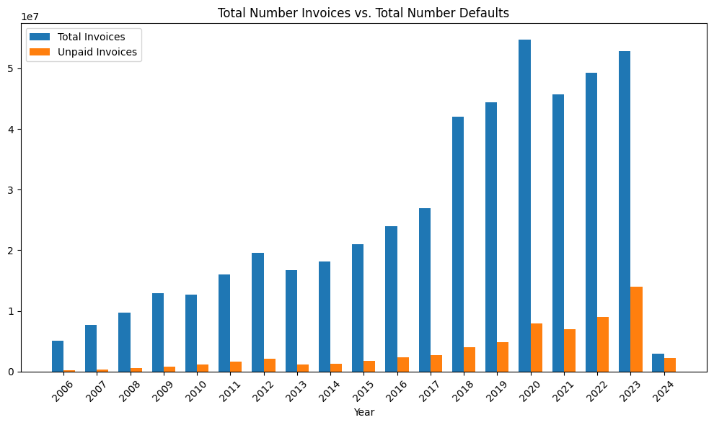
Difficult to compare
Might be better to look at # CHANGE in total vs. # CHANGE in defaults to get better understanding of effects of new groups

Slide 4
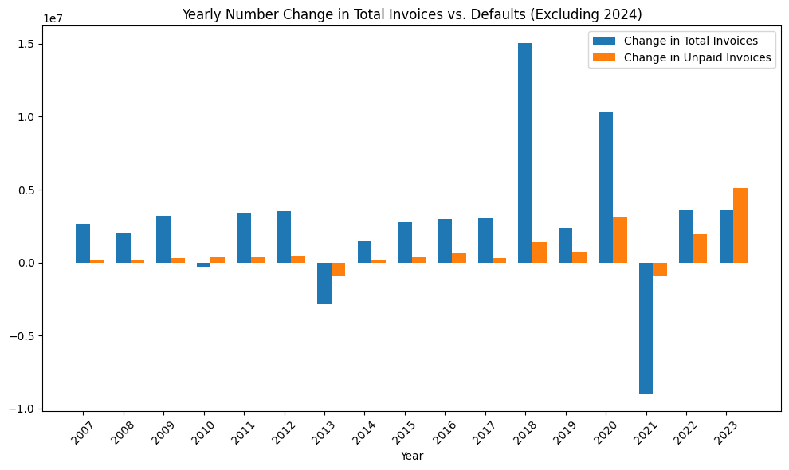
Doesn’t seem to be a pattern, doesn’t seem that the increased defaults are coming from new users (until 2023?)
2023, seems that perhaps both new and old could be defaulting
Perhaps look at % change in defaults instead (instead of # change), still compared to # change in total invoices

Slide 5
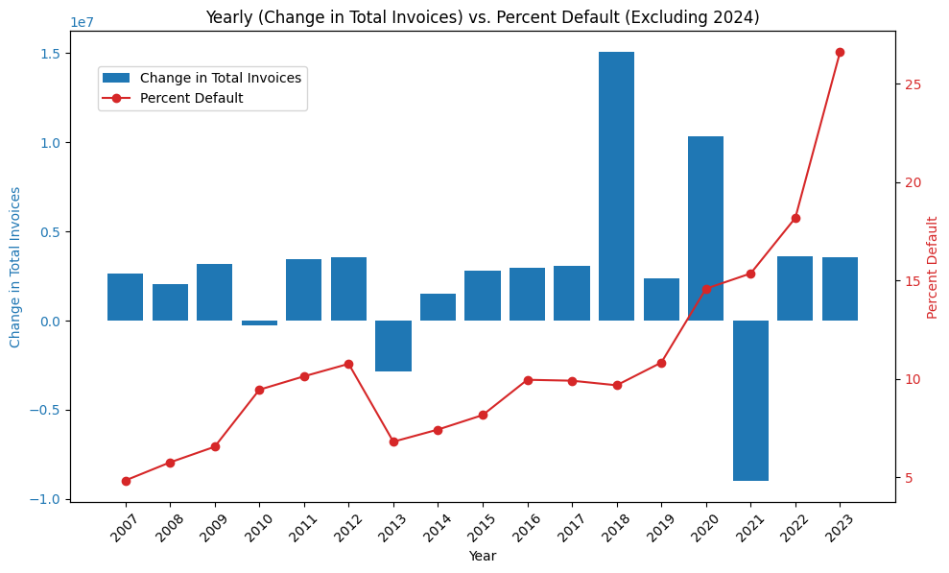
Doesn’t seem to be a pattern in # change in total invoices vs. % change in defaults
Indicates new users not systematically more/less likely to default (if old users stay same, but this is not yet verified)

Slide 6
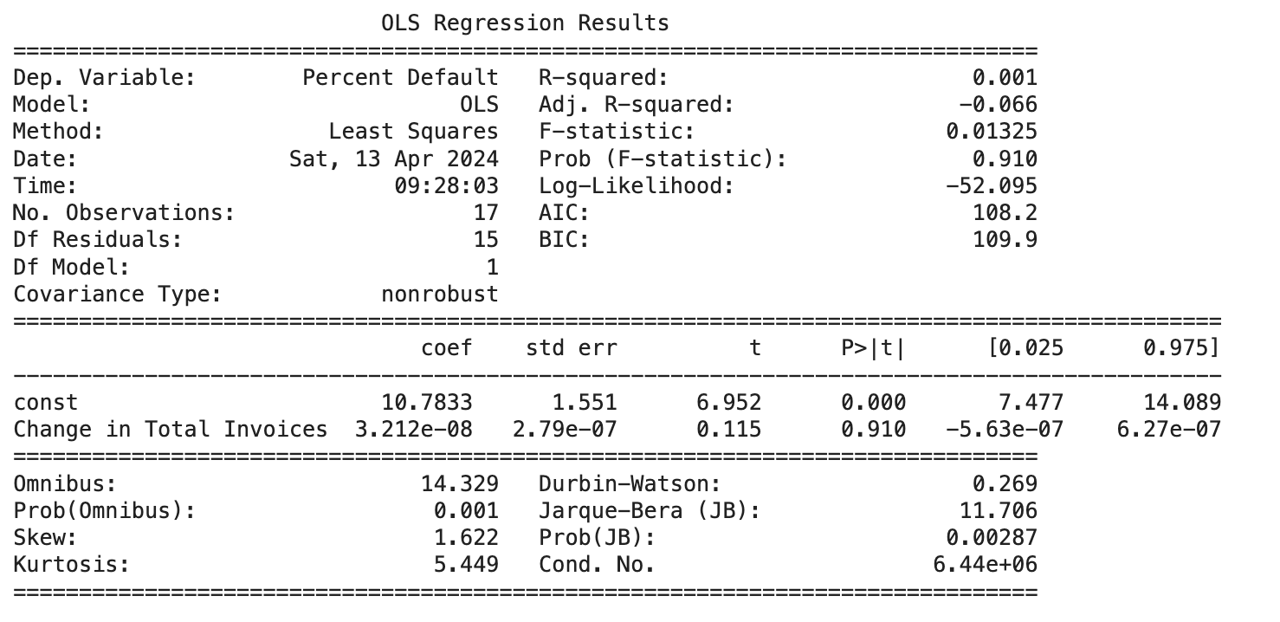
Indeed no relationship
Perhaps look at % change in total invoices vs. % change in default

Slide 7
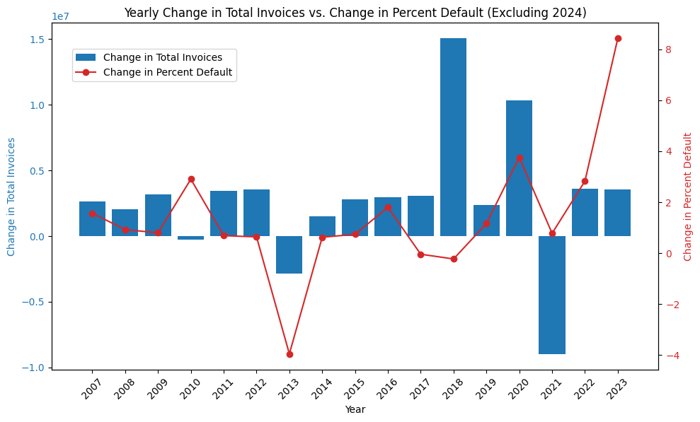
Doesn’t seem to be a pattern in % change in total invoices vs. % change in defaults
Indicates new users not systematically more/less likely to default (if old users stay same, but this is not yet verified)

Slide 8
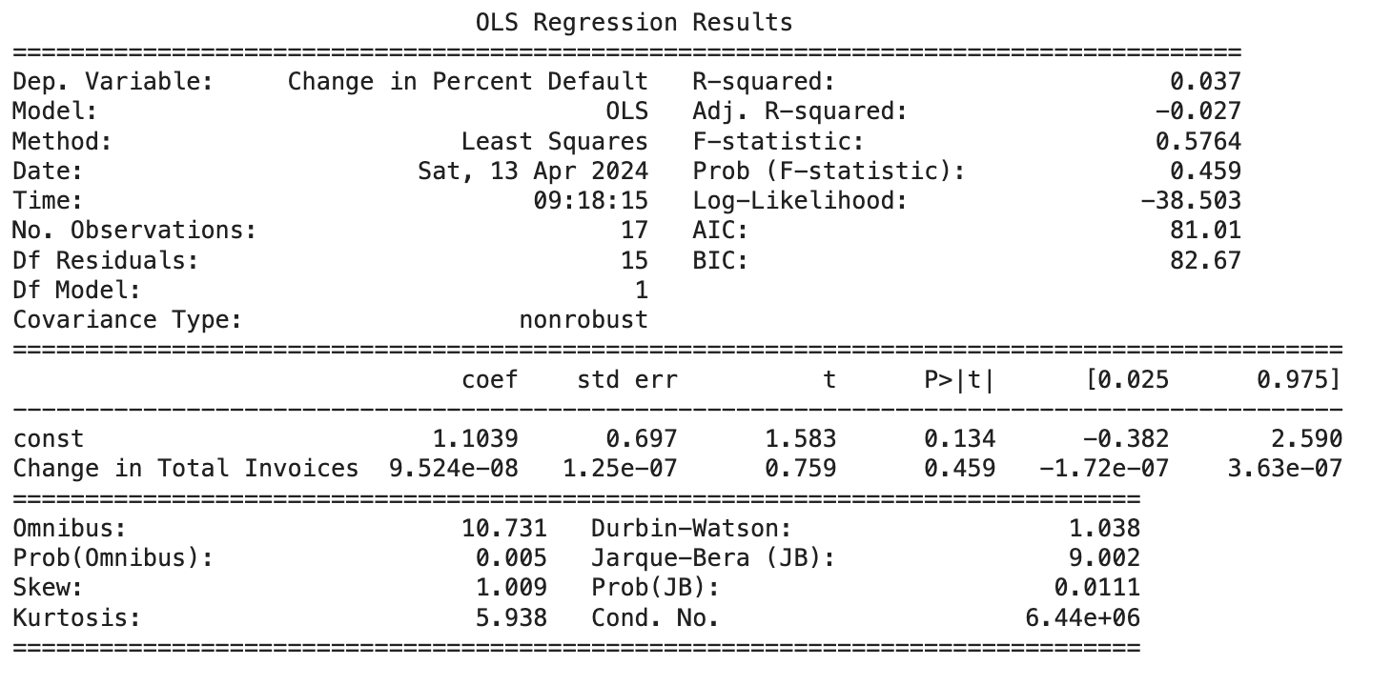
Indeed no relationship

Slide 9
Conclusion: Need of systematic assessment of New Users
There is no systematic evidence suggesting that newer user groups are more likely to default if the behavior of older users remains constant.
It is crucial to segregate user data by year joined to validate these assumptions and understand underlying influences
Later plots show behavior/statistics of different user groups (grouped by year-joined), over time.

Slide 10
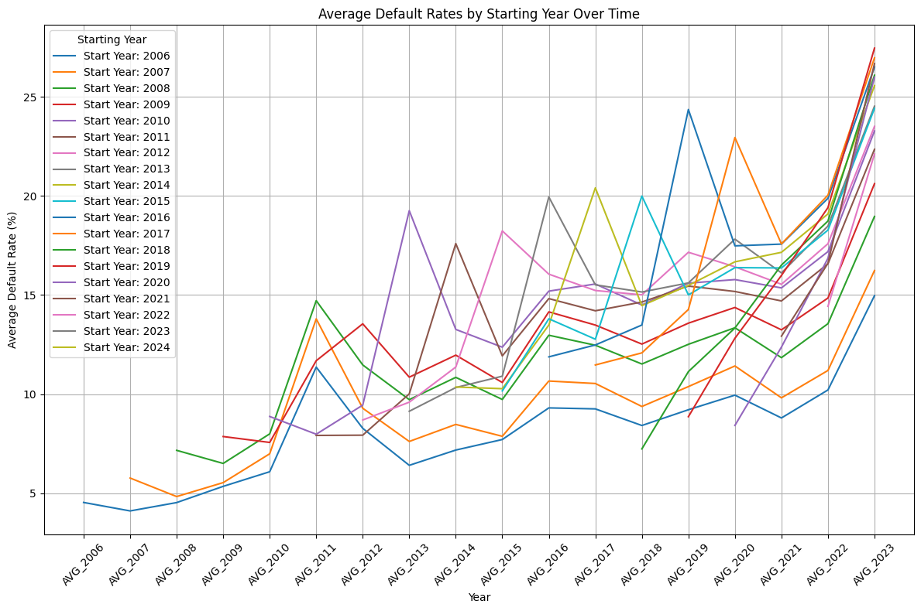
ALL user groups more likely to default with time
User groups (starting 2006-2009, 2018-2020) have lower default starting point
User groups 2006-2009 default rates remain low throughout years
Not true for user groups 2018-2020

Slide 11
Perhaps different groups have different transaction amounts (significantly related to default rates?)

Slide 12
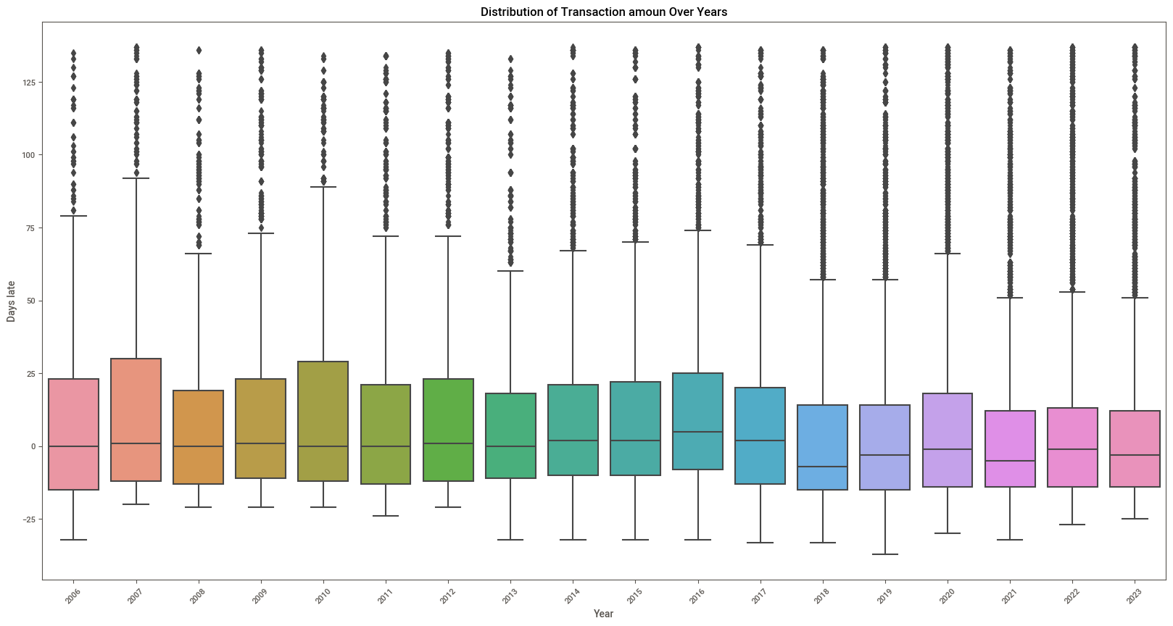
ungrouped

Slide 13
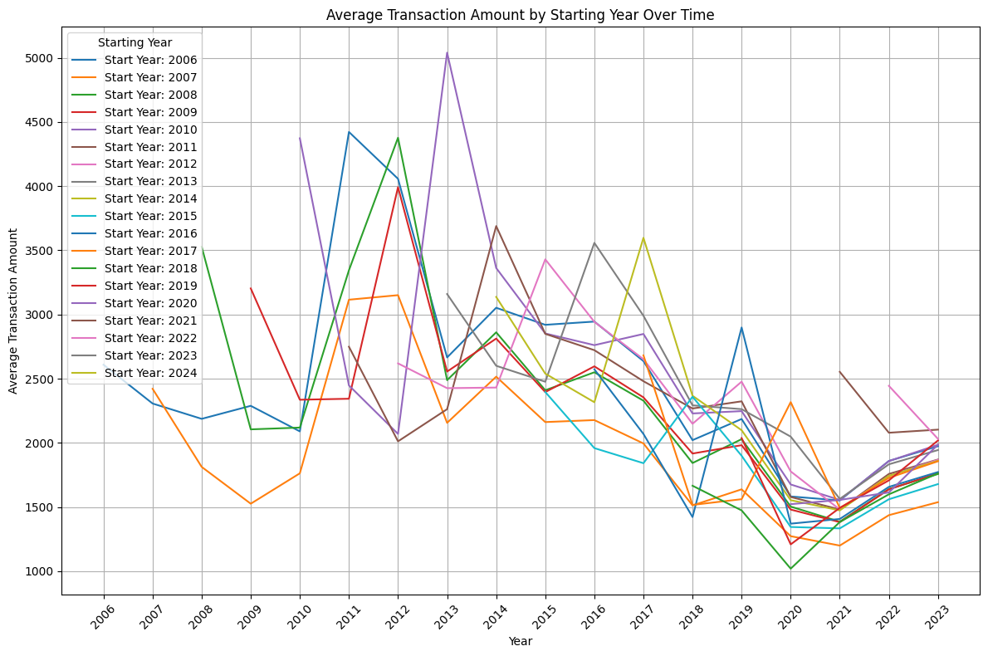
Inverted U-curve for ALL user groups
No overall trend indicating that newer groups engage in either higher or lower transaction amounts,except for the 2022 and 2023 cohorts (based on limited data , require cautious interpretation)

Slide 14
Perhaps different groups have different # vehicles (related to default rates?)

Slide 15
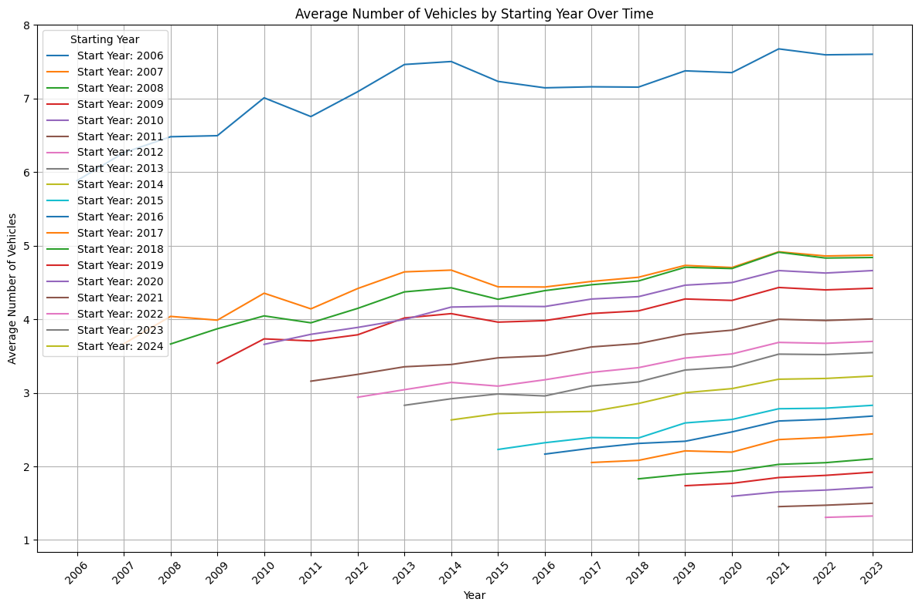
YES
Decrease in the average number of vehicles per consumer in newer groups,
Suggests potential correlations between vehicle ownership

Slide 16
Perhaps client categories, within each group (based on year-joined) have different default rates?

Slide 17
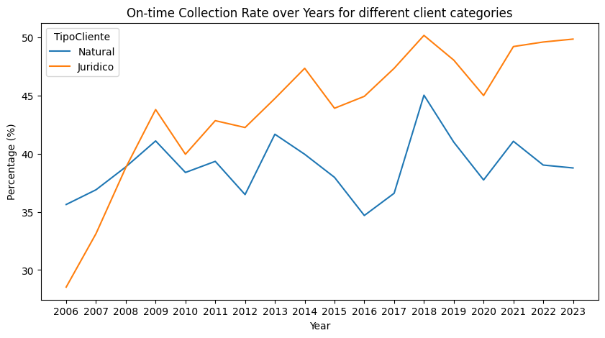
ungrouped

Slide 18
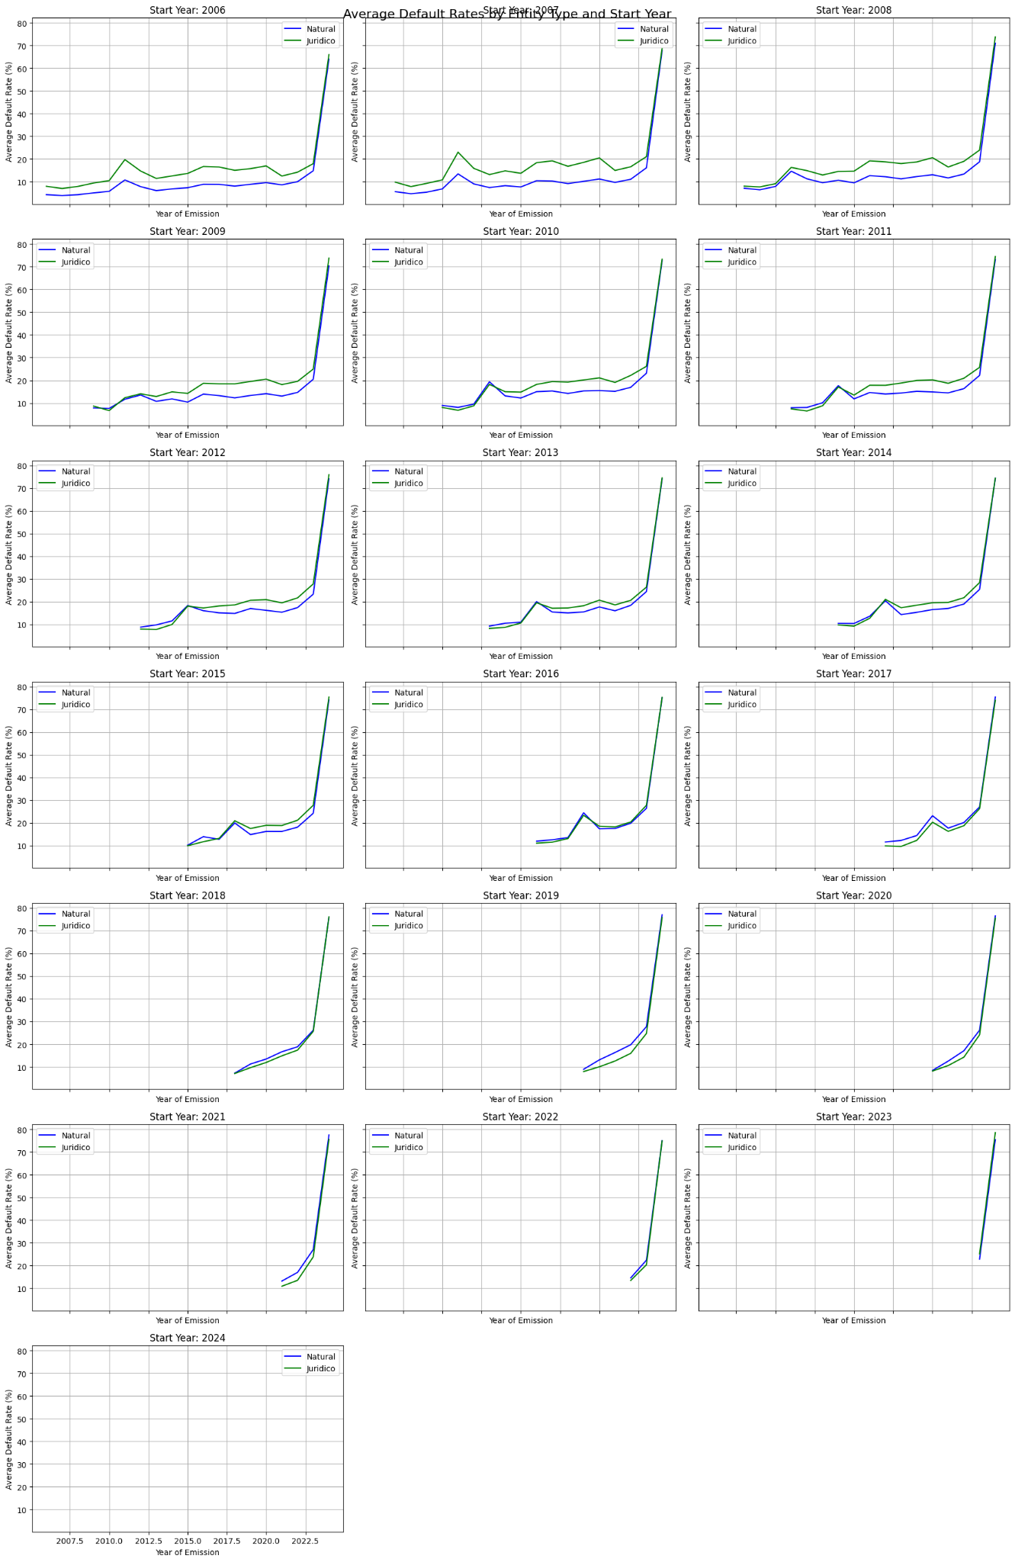

Slide 20
Confusing results: Inconsistent Trends
Legal entities that joined in earlier years exhibit higher default rates compared to natural users from the same period. However, legal entities that commenced their accounts post-2017 display lower default rates.
But in the first graph (aggregated), legal entities having higher default rates in later years as well?
Potential explanation: number of users accumulated over the earlier years offset the trend of lower default rates for later-joined entities, but the yearly invoice number doesn't seem to support this, unless the early joiners are spending considerably more. But transaction data (grouped) doesn’t support this either?

